Slide 1
Marvel Studios - Secure Image Solution (MS-SIS)
New York University
IMS – Spring’17
Project Team:
Aviraj Ajgekar (aa4691)
Shikshya Bhattachan (sb5925)
Abhishek Balaji Venkataraaman Sangheetha (avs395)
New York University

Slide 2
Agenda
Introduction
MS-SIS - Current State of Business
Information Security Risks and Priorities
Goals and Guiding Principles
Governance & Management
Assurance & BCDR
Strategy & Roadmap
Next Steps & Q&A

Slide 3

MS- SIS
Solution
External Clients/MS Photographers
MS-SIS Boundary in the Public Cloud
MS Cloud and Security Administrators
MS Application Managers
Cloud Subscription
Container (Resource Group)
Management
Access Control
Encrypted
Data
(Images, Contract
Documents, Invoices)
Encryption
In Transit TLS/HTTPS
MC Client
App
Data
Access
Control
Cloud Identity
Key Management Store

Slide 4

Functional Flow - MS- SIS
Envelope Encryption:
User brings Key Encryption Key (KEK) to key store
Storage client generates a Content Encryption Key (CEK)
User data is encrypted using CEK
CEK is wrapped using Key Encryption Key (KEK)
Key wrapping method specified by the developer
Storage client never has access to the KEK
Encrypted data along with wrapped CEK is stored as metadata on the encrypted object
User brings KEK (Key Encryption Key)
Authentication,
Key Management Service
Cloud Storage Client Library
Storage Client Generates CEK
Key Management Store (KMS)
User Data Wrapped CEK with KEK
Wrapped CEK,
Key ID, IV,
Encrypted Content
Cloud Storage
Envelope Encryption:
Key Encryption Key (KEK)
Content Encryption Key (CEK)

Slide 5
Information Security Risks
We have a 4 category impact and likelihood scale based on how the system is affected : Low, Moderate, High, Critical.
Scale | Impact
Low | This scale is used to define low level threats that affect the organization on a small scale. Since we are using a public cloud service to store data there are risks surrounding this which will not cause a direct impact on Marvel Studios. Additionally, this impact scale is also used to categorize financial and regulatory compliance which may cause small issues that may occur infrequently.
Moderate | This scale is used to define risks that affect the organization on a moderate scale. This scale is for threats that have a possibility of happening more than the Low scale. Additionally, this impact scale also categorizes threats that may happen day to day and not cause any major problems in the work flow but could cause serious problems if not treated eventually.
High | This scale is used to define risks that may have a severe impact on Marvel Studios , organizational operations, assets and individuals involved , the threat event that fall in this category may (i) cause a severe degradation in or loss of mission capability to an extent and duration that the organization is not able to perform one or more of its primary functions; (ii) result in major damage to organizational assets; (iii) result in major financial loss; or (iv) result in severe or catastrophic harm/loss to individuals .
Critical | This category is used to define risks that may cause multiple severe or catastrophic impacts on Marvel Studios

Slide 6
Information Security Risks
Quantitative measure of the impact scale
Likelihood
 | Low | Moderate | High | Critical
Loss (monetary) | <1k | 1k-100k | 100k-10M | >10M
Legal | Fine | Small claims court | Individual Law suits | Class Action Law suit
Safety | None | Minor Injury | Hospitalization Required | Permanent damage / death
Safety (Assets/ Operations) | Minor bugs |  | System crashes | Total System failure
Scale | Likelihood
Low | The event is not very likely to occur; i.e., once or twice a year
Moderate | The event is somewhat likely to occur; i.e., 1-10 times
High | The event is most likely to occur
Critical | The event is almost certain to occur

Slide 7
IT assets at risk based on impact.
IT asset | CIA | Impact
MS-SIS Informational Assets (mass) | C | Critical
MS-SIS Informational Assets (isolated) | C | High
MS-SIS Business Processes (Mass) | I | Critical
MS-SIS Business Processes (Isolated) | I | High
MS-SIS Business Processes (mass) | A | Critical
MS-SIS Business Processes (Isolated) | A | High
MS-SIS Key Establishment Process (Mass) | C | Critical
MS-SIS Key Establishment Process (Isolated) | C | Moderate
MS-SIS Key Management Process (Mass) | I | Critical
MS-SIS Key Management Process (Isolated) | I | High
MS-SIS Operational Assets Inventories (Mass) | C | Moderate
MS-SIS Operational Assets Inventories (Isolated) | C | Low

Slide 8
Likelihood of specific threat agent
Threat / Threat agent Objective | Outsider Likelihood | Insider Likelihood
MS-SIS Informational Asset | Critical | High
MS-SIS Business Processes | High | High
MS-SIS Keys | Critical | High
MS-SIS Operational Assets | High | Moderate
Hackers | High | Moderate
Foreign hackers | Moderate | Low
Corporate spies | Moderate | Moderate

Slide 9
Vulnerability Assessment
Vulnerable areas :
Threat / Threat agent Objective | Vulnerable Areas | Comment
MS-SIS Informational Asset | MS-SIS (C) (I) | Accessing the Informational assets would mean the whole system has been compromised
Upload/download failure | MS-SIS Business Process (A) (I) | The attacker will try to deny or spoof the connection to make it look like it is geniune
Hackers (DOS) | MS-SIS Business Process (A) MS-SIS (A) | The hackers may try to target the Business process to prevent the user agents from accessing it
Stealing MS-SIS Keys | Key Management Store (C ) (I ) | The threat agents are most likely to target the Keys used by the user agent
Corporate spies | MS-SIS (C ,I, A) | Corporate spies hired by other agencies might target the whole system to either collapse the system, compromise integrity or deny availability

Slide 10
Vulnerability Assessment
IT Asset at risk | CIA | Impact | Threat | Vulnerable Area | Likelihood (O=Outsider , I=Insider)
MS-SIS Informational Assets (Mass) | C | Critical | Steal | MS-SIS | Critical (O) High (I)
 | I | Critical | Hacker |  | Critical (O ) High (I)
MS-SIS Informational Assets (Isolated) | C | High | Steal | MS-SIS | High ( O) Moderate (I)
 | I | High | Hacker |  | High (O) Moderate(I)
MS-SIS Business processes(mass) | A | Critical | Hacker (DOS) | Business Process | Critical (O) High (I)
 | I | Critical | Hacker |  | Critical(O) High(I)
MS-SIS Business processes (Isolated) | A | High | Hacker(DOS) | Business Process | High (O) High(I)
 | I | High | Hacker |  | Critical (O) High(I)
MS-SIS Keys(mass) | C | Critical | Steal | Key management store | Critical (O) High (I)
MS-SIS Keys (Isolated) | C | Moderate | Steal |  | High (O) Moderate(I)
MS-SIS Operational Asset Inventory (mass) | C | Moderate | Steal | MS-SIS | Moderate (O) Low(I)
MS-SIS Operational Asset Inventory (isolated) | C | Low |  |  | Low(O) Low(I)

Slide 11
Prioritized Risk table
Threat | Impact | Likelihood (O= Outsider , I=Insider) | Risk Priority
SIS Key Establishing Process (Mass) | Critical | Critical(O) High (I) | 1
MS-SIS Information Assets (Mass) | Critical | Critical(O) High (I) | 1
MS-SIS Business Process(mass) | Critical | Critical (O) High(I) | 1
SIS Key Establishing Process (isolated) | High | High (I OR O) | 2
MS-SIS Information Assets (isolated) | High | High(O) | 2
MS-SIS Informational Assets (Isolated) | High | Moderate(I) | 3
MS-SIS Business Processes (Isolated) | Moderate | High (O or I) | 3
MS-SIS Operational Assets(Mass) | Low | Moderate(O) Low(I) | 4
MS-SIS Operational Assets (Low) | Low | Low(I or O) | 4

Slide 12
Security Engineering
Threat | Impact | Likelihood (O=Outsider , I=Insider) | Risk Priority | Security Requirements
SIS Key Establishing Process (Mass) | Critical | Critical(O) High (I) | 1 | SR 1: The key must withstand common decryption techniques (Brute force for example) SR 2: Keys must not be stored in an encrypted format. SR 3: Keys must be changed regularly
MS-SIS Information Assets (Mass) | Critical | Critical(O) High (I) | 1 | SR 4: The Asset can only be accessed by authorized personnel SR 5: Use access control so that only user agent’s data can be accessed. (for system admin) SR 6: Provide immutable logging for all access SR 6a: Regular audits of access logs SR 6b: Strict background checks of system admin SR 7: Protect confidentiality of data on transit (network links) SR 8: Constantly backup data

Slide 13
MS-SIS Business Process(mass) | Critical | Critical (O) High(I) | 1 | SR 9: Protect all connections to block known attacks SR 10: Use secure application software configurations SR 10a: Maintain Security patches for application software
SIS Key Establishing Process (isolated) | High | High (I OR O) | 2 | Already dealt with by SR 1, SR 2, SR 3
MS-SIS Information Assets (isolated) | High | High(O) | 2 | SR 11: Data must be securely encrypted before uploading SR 12: Each log in by user agent must be logged.
MS-SIS Informational Assets (Isolated) | High | Moderate(I) | 3 | Dealt with by SR 4-8 and SR 11, SR 12
MS-SIS Business Processes (Isolated) | Moderate | High (O or I) | 3 | Covered in SR 9, 10
MS-SIS Operational Assets Inventory(Mass) | Low | Moderate(O) Low(I) | 4 | SR 13: The asset (inventory) must be regularly checked for unauthorized changes
MS-SIS Operational Assets Inventory (Low) | Low | Low(I or O) | 4 | Covered in SR 13

Slide 14
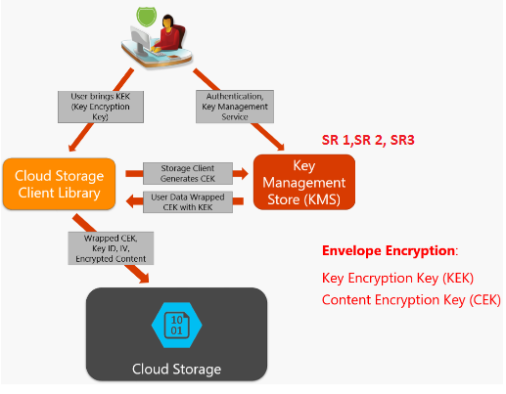
Security Engineering
Security Requirements on Functional Flow Diagram

Slide 15
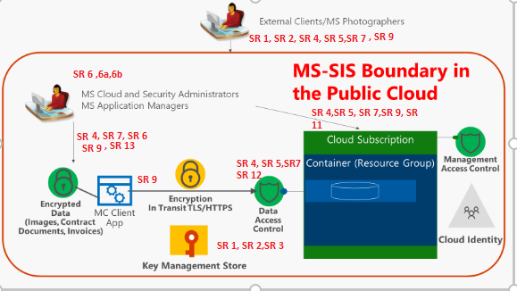
Security Requirements on MS-SIS System Boundary Diagram

Slide 16
Trade Study For Selection of interface for external users Trade Study For Selection of interface for photographers, sys admin
Criteria | Web Browsers | Thick Client | Cloud backend access
Security | 3 | 3 | 4
Initial Cost | 4 | 2 | 4
Maintenance Cost | 3 | 2 | 1
Ease of use | 4 | 4 | 1
Total Score | 3.25 | 2.5 | 0
Criteria | Web Browsers | Thick Client Application | Cloud backend access
Security | 3 | 3 | 4
Initial Cost | 3 | 3 | 4
Maintenance Cost | 3 | 1 | 2
Ease of use | 4 | 4 | 2
Total Score | 3.5 | 0 | 2.8

Slide 17
Goals
The following are the five goals that Marvel Studios will aim to achieve:
Protect the confidentiality of the data
Preserve the Integrity of Data
Improved Security of System and Network Services
Proactive Risk Management
Crisis and Security Incident Management

Slide 18
Guiding Principles
We will use the guiding principles as suggested by RSA Executives who offer seven guiding principles to maximize megatrends redefining the information security industry:
Security must be embedded into the IT Infrastructure
Develop ecosystems of solutions
Create seamless, transparent security
Ensure security controls are correlated and content aware
Security must be both outside-in and inside-out focused
Security has to be dynamic and risk-based
Effective security needs to be self-learning

Slide 19
Governance Model
Three tier Governance with roles and rules for each tier
Marvel Studios
Decision Structure
Decision making
MS-SIS Governance Model
Implementation
Operating Processes
Collaboration Enablers
Communication

Slide 20
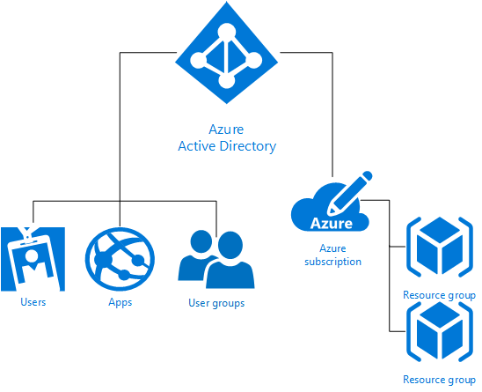
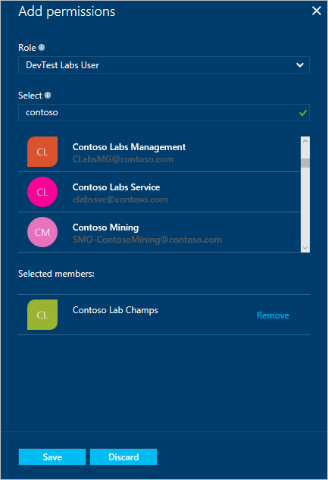
Management of Deployed System – IAM/RBAC
RBAC using Custom Roles and Permissions for MS-SIS
Cloud based Hybrid Identity
Reference: Microsoft Azure RBAC

Slide 21
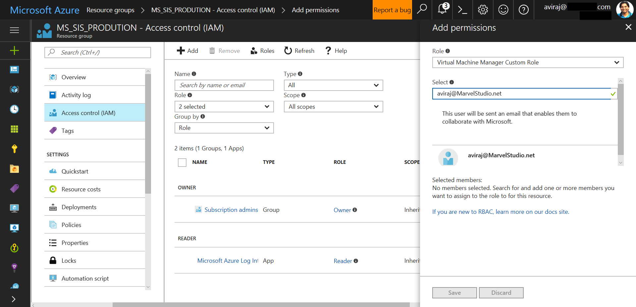
Reference: Microsoft Azure RBAC

Slide 22
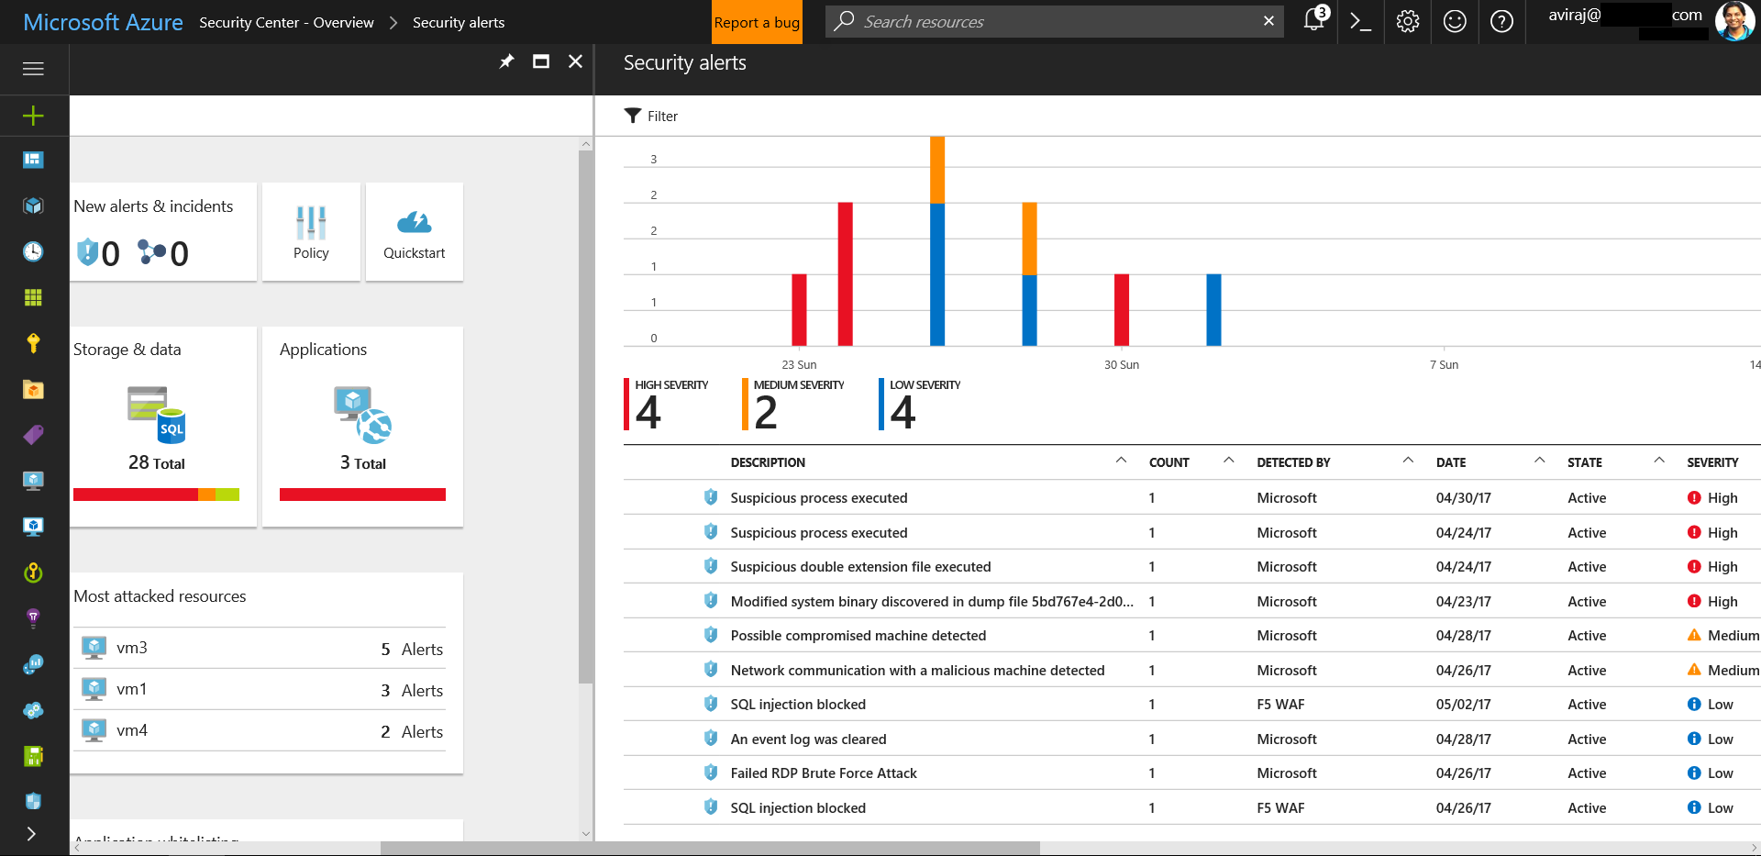
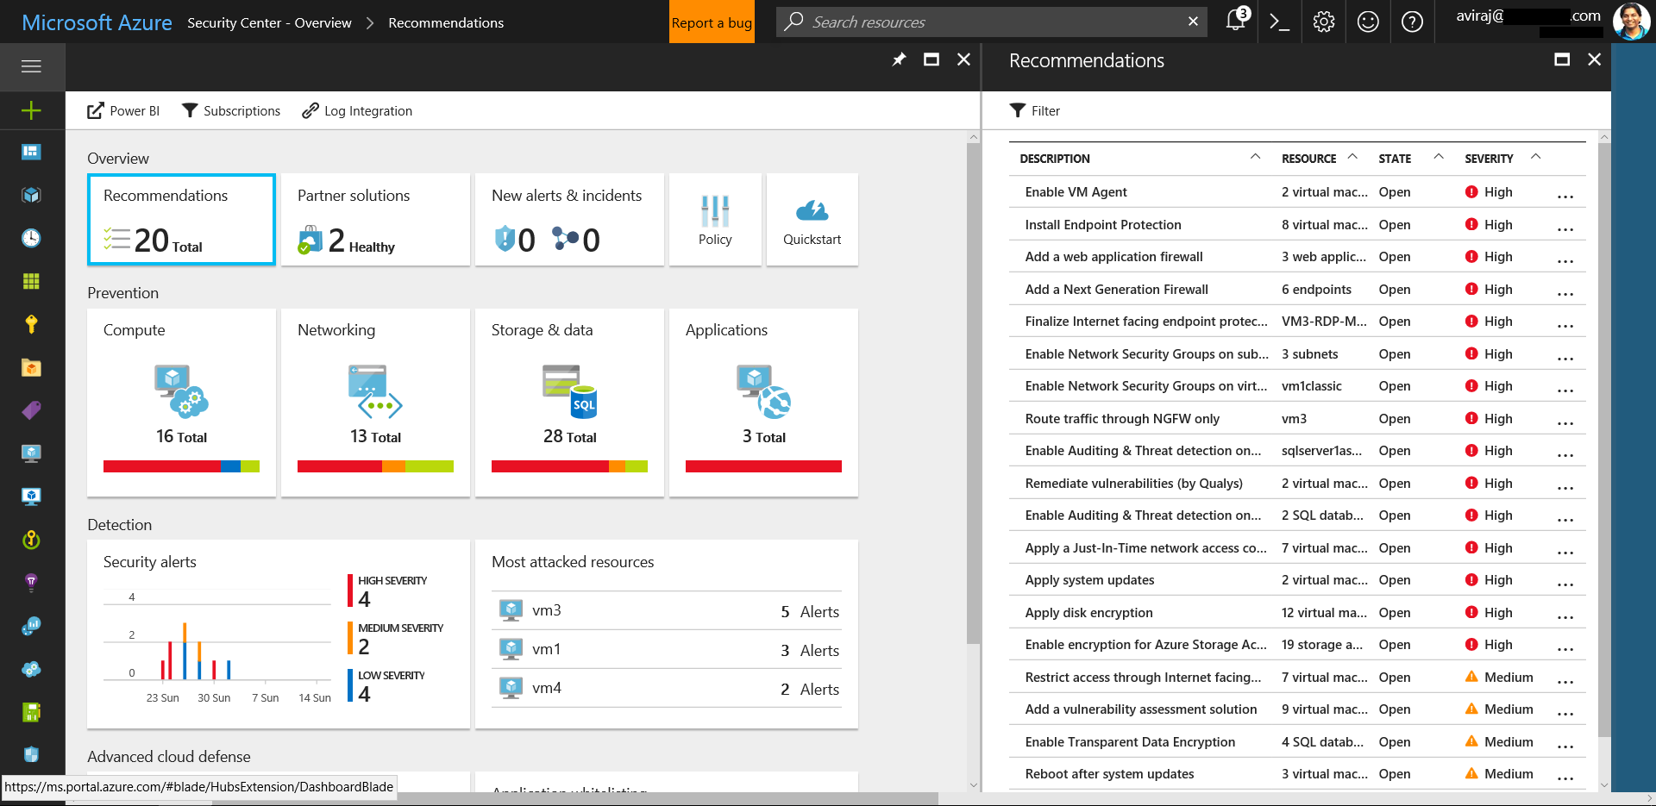
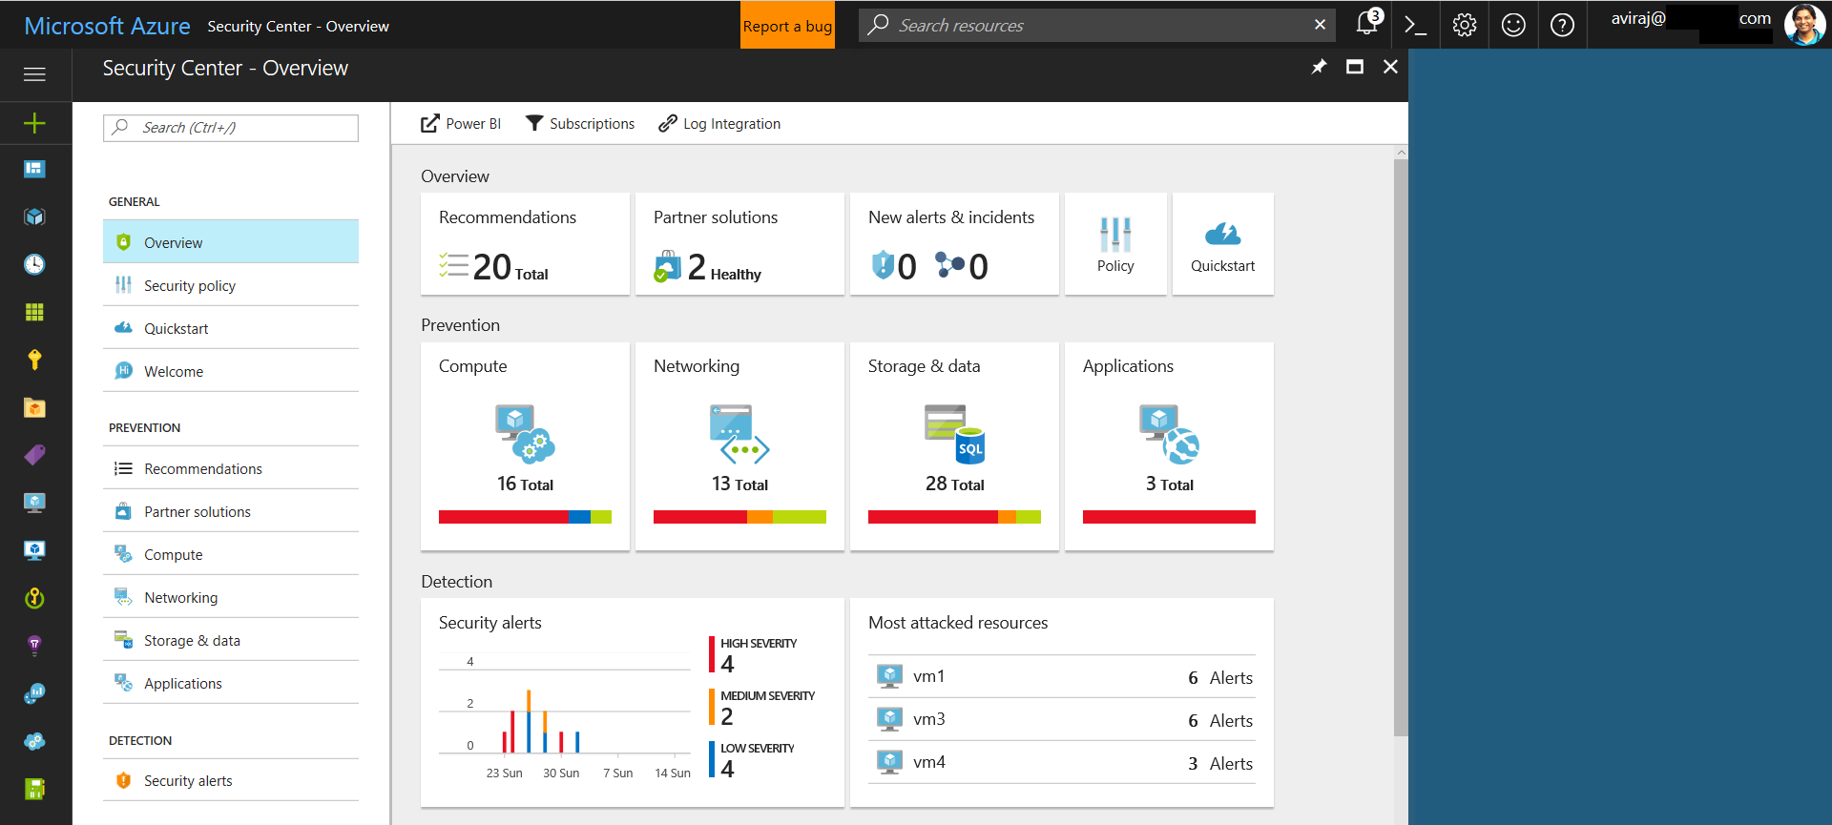
Management of Deployed System – Security
Reference: Microsoft Azure Security Center

Slide 23
"How would you go about verifying the data you are getting for 3rd party assessment?"
Audit & Diagnostics Logs the Platform
SIEM Tool Integration from MS-SIS Platform
Penetration Testing/Auditing by Marvel IT Team
ISO and SOC Compliance Reports
Trending Analysis (Machine Learning based model)
Datacenter Tours by 3rd Party Cloud Providers

Slide 24
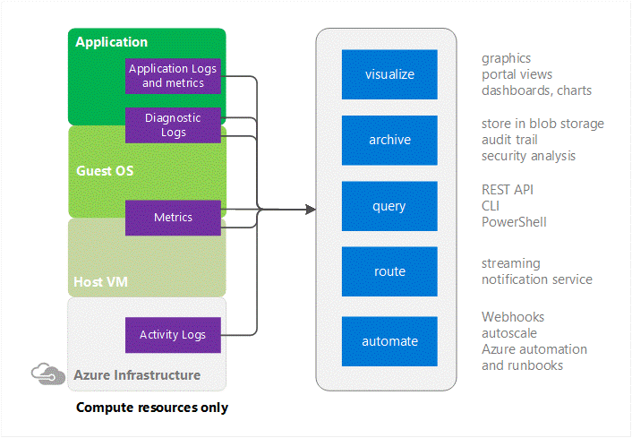
MS-SIS Operational Security
Reference: Microsoft Azure Operational Security

Slide 25
Assurance
Assurance means the guarantee that our system is
doing what it is supposed to do – providing us with
the service, and also ensuring that necessary controls
are in place.
It provides us with the computer security functions
such as – Confidentiality, Integrity, Availability,
Authenticity, Non-Repudiation and Confidentiality
of user data.
It uses all – physical, technical and administrative
controls to accomplish these task.

Slide 26
Contingency Planning
This includes :
Business Impact Analysis (BIA)
Incident Response Plan (IRP)
Disaster Recovery Plan (DRP)
Business Continuity Plan (BCP)

Slide 27
Contingency Framework

Slide 28
Strategy Roadmap for 3 Years
International Expansion in 10 Countries by 2020
Global Compliance (E.g. GDPR)
Migrate 80-90% IT Infrastructure to Cloud by 2020
Monitor, Prevent & Detect new & existing Threats E.g. Ransomware - What if celebrity database gets attacked??
Just-In Time Access – MS-SIS Infrastructure
Just-Enough Access – MS-SIS Infrastructure
Next-Gen Development Platform for MS-SIS
E.g. Containers, BlockChain, HoloLense, .NET STANDARD
Notes:
GDPR - The General Data Protection Regulation (GDPR) is a Regulation in the making by which the European Commission intends to strengthen and unify data protection for individuals within the European Union (EU). It also addresses export of personal data outside the EU.

Slide 29
Q&A THANK YOU

